Slide 1


Marketing & Retail Analytics Capstone Project
By Madhura Pathak
Cohort – DS INTL C2

Slide 2

AGENDA
Objective
Background
Key findings
Recommendations
Appendix :
Data Sources
Data Methodology
Data Assumptions

Slide 3
OBJECTIVE
Identify top products that contribute to the revenue.
To analyze which items are more likely to be purchased individually or in combination with some other products.
To know what is ideal category depth & identify the product categories which they can get rid of without significantly impacting business.

Slide 4
BACKGROUND
In the recent past, e-commerce companies have emerged and flourished in the industry. They offer the convenience to order from a wide variety of options from the comfort of one’s home. But how do they offer these “wide variety of options or products”?
Any e-commerce company would obviously need to store tons and tons of products in warehouses to meet the customers' demands. Now, some of these warehoused products might be fast-moving products that sell very quickly, and some others might be slow-moving. Each of the products being stored incurs a cost to the company in terms of space and maintenance. Since storing these products obviously adds to the costs that the company incurs, it is absolutely necessary for the organizations to plan their inventory well.
OList is one such e-commerce company that has faced some losses recently and they want to manage their inventory very well so as to reduce any unnecessary costs that they might be bearing.

Slide 5
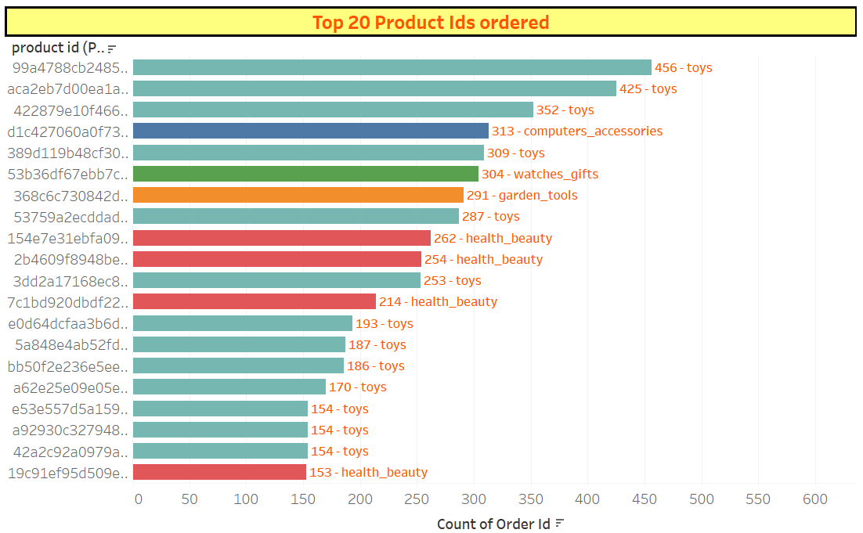
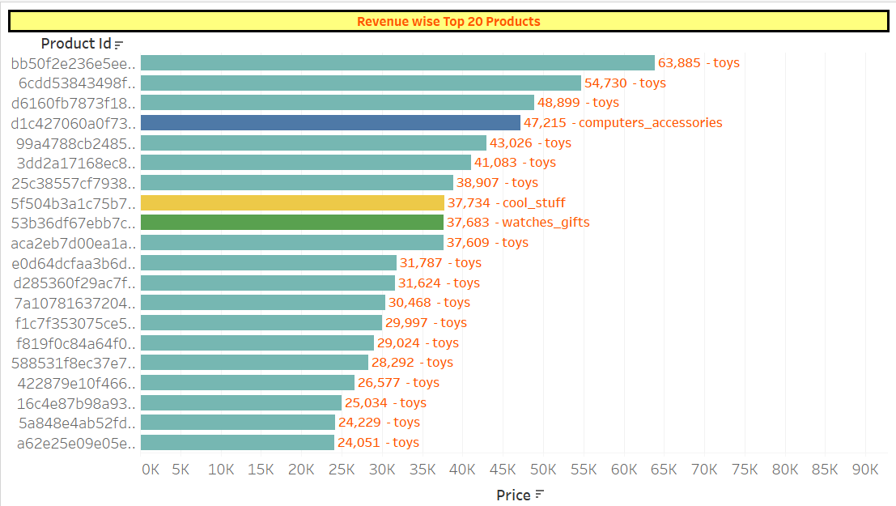
KEY FINDINGS
Toys form the major chunk of the ordered and revenue-generating category toys, bed_bath_table and health_beauty are amongst the top product categories ordered the most.
Toys, watches_gifts and health_beauty are amongst the top product categories having highest revenues.
Cool_stuff is not in the top 20 ordered products but is among the top 20 revenue-generating products.
Garden-tools and health_beauty are in the top 20 ordered products but are not in the top 20 revenue-generating products.

Slide 6
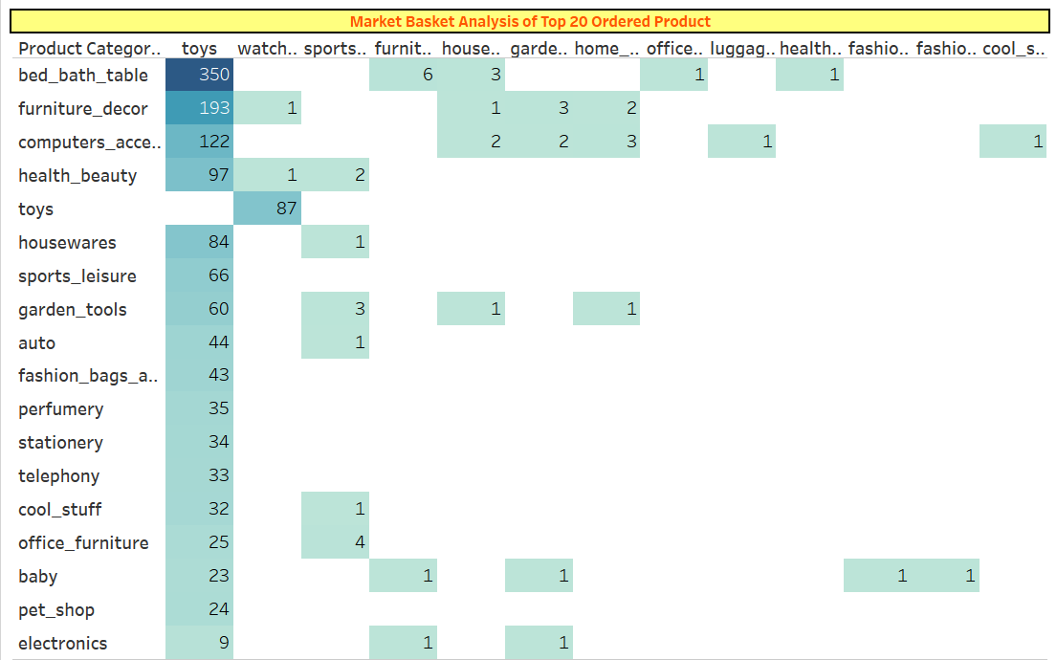
Market basket Analysis Toys form the main category of the market basket analysis with whom we get associations of other categories. The major association is seen of toys with bed_bath_table, furniture_decor, computer accessories,health_beauty and watches_gifts. Apart from the association of toys, we do not observe a strong market basket association with any other product categories.

Slide 7
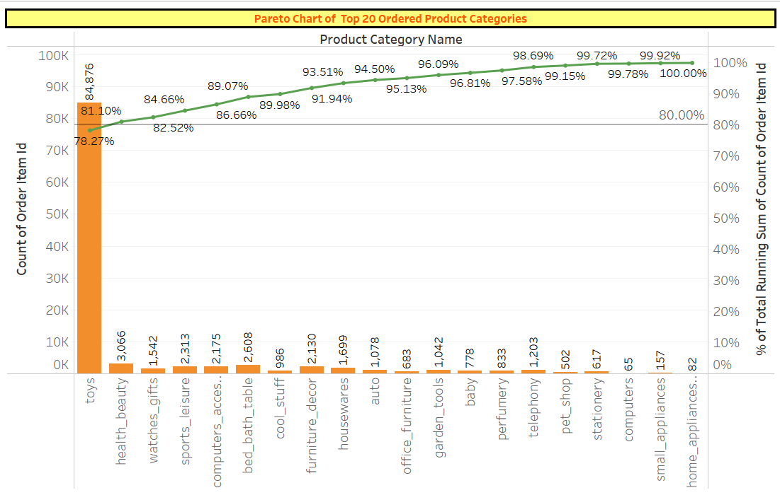
Top 20 ordered products

Slide 8
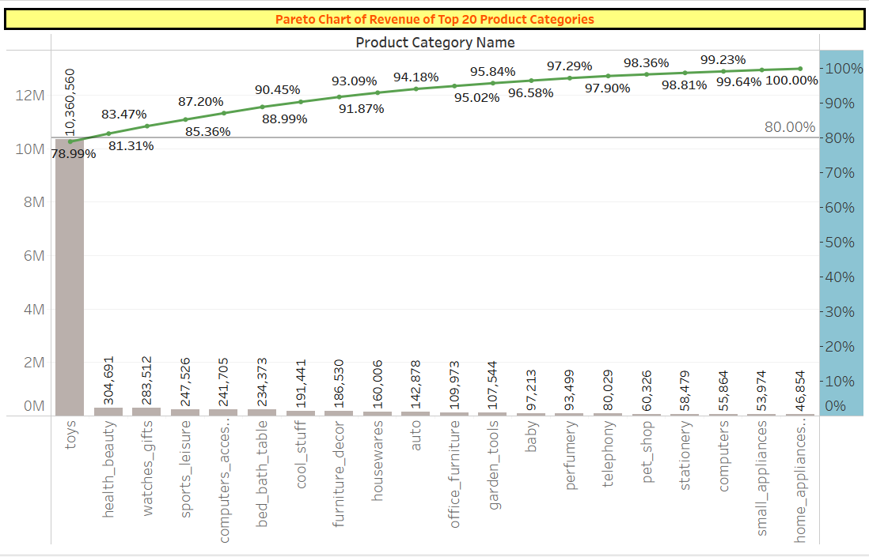
Top revenue contributors- Toys contribute almost 80% of the total revenue for olist . If we consider the 85% - 15% pareto rule, we can see that along with toys, health_beauty, watches_gifts, sports_leisure contribute to 85% of the revenues. So only 4 categories out of the top 20 revenue-generating categories contribute to 85% of revenue

Slide 9
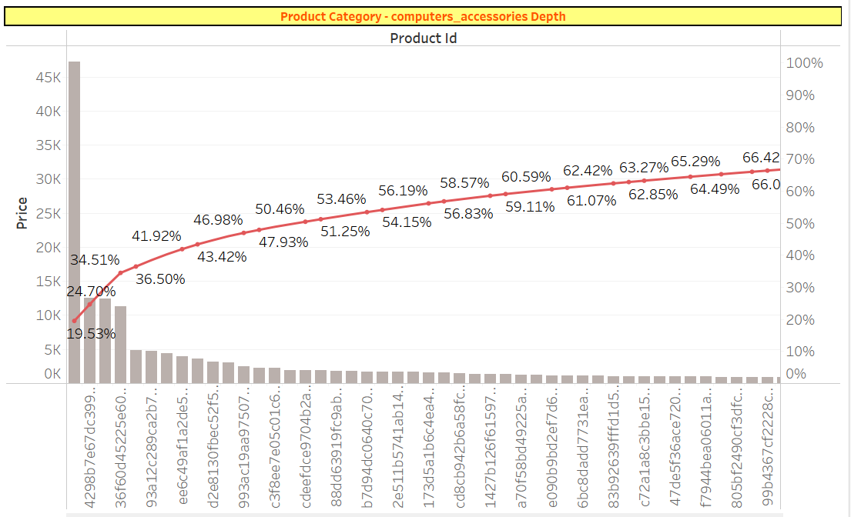
Product depth If get into the product profile (product_id) of each category, then, the number is quite large but revenue generation from each product_id is very limited, apart from a few. To make olist’s product list leaner, we can follow the same principle and keep product_ids which contribute to the 80% of revenue generated by that category, and the rest we can drop off. This will ensure we have the right product category depth and also lose unnecessary weight of the product_ids which donot add much to the revenue.

Slide 10
recommendations
There is too much dependency on one category i.e. Toys as we observed Toys form the major chunk of the ordered and revenue-generating category. We recommend to tone down its sales. We have to diversify the products to minimize the risk.
Focus should be shifted to increase order of remaining top 19 revenue generating categories, we can increase revenue & balance the product stock too.
cool_stuff is not in the Top 20 ordered products but is among the Top 20 revenue-generating products. We need to try to increase stock & sale of these.
Similarly, Garden-tools and health_beauty are in the Top 20 ordered products but are not in the Top 20 revenue-generating products. We can increase price of this to increase profit.
Product Categories have too many products_ids which has very low transaction level, those should be dropped off the list. Follow the Pareto principle of 80/20. Keep product_ids which contribute to 80% of the total individual category revenue and the shed rest 20% from the product repertoire. This will ensure optimum Product Category depth and reduce unnecessary costs on low-transaction products

Slide 11
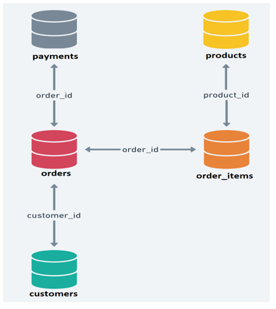
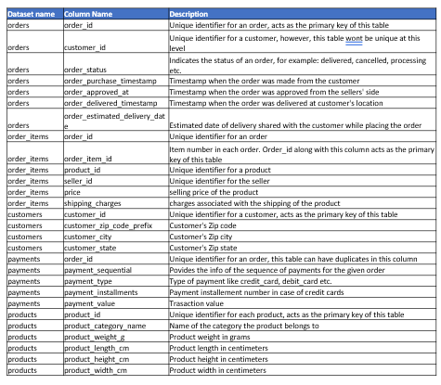
APPENDIX – Data source
We were provided with a Retail Dataset
The data dictionary and ERD diagram helped in getting the basic idea of the dataset and the relationship each sheet had

Slide 12
Appendix – Data Methodology
Cleaning the data by checking to remove the null values of columns with median values.
Outliers were not dealt with as we felt that each data point was necessary for the analysis.
Retail_dataset_cleaned was imported into Tableau with the relationship defined as per the ERD diagram provided
For MBA, the Market_Basket_Analysis dataset was separately created, exported to excel and then imported to tableau. Self-join (inner) was done on order_id and the second join was done on product_category_name less than product_category_name.
The cleaning of data was conducted in Python and the visualizations were done in Tableau

Slide 13
Appendix – Assumptions
Sum of Price is assumed to be the revenue generated for getting valuable insights.
In some cases, we have assumed the Pareto principal rule as 85/15 instead of 80/20 based on the insights found.

Slide 14

Thank you !

